Slide 1
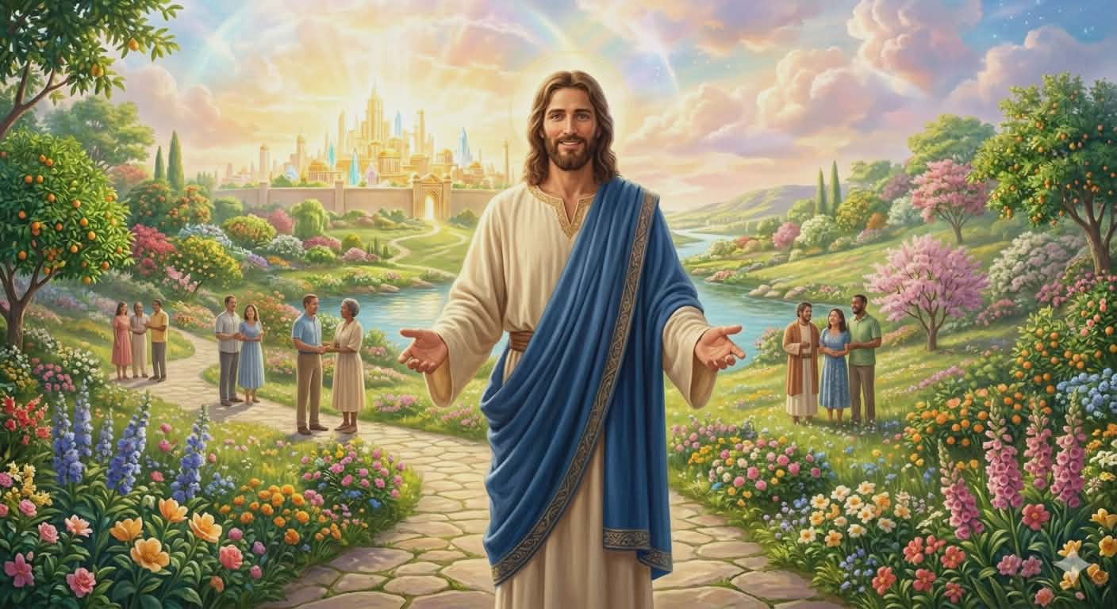
Important Principles on Stewardship
Prepared By:
Pastor Ildefonso A Baquilabat

Slide 2
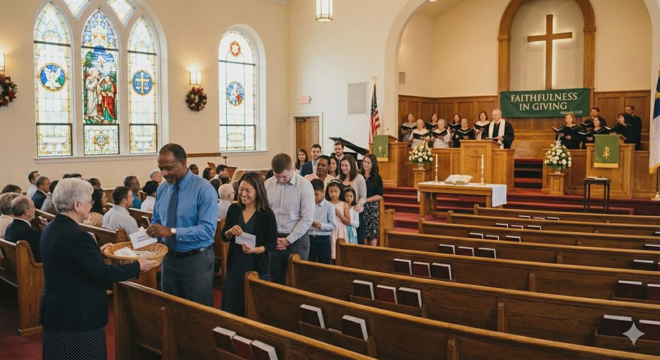
1. Do not Publish Giving; it’s only Between you and your God.
“Christ's own words make His meaning plain, that in acts of charity the aim should not be to secure praise and honor from men.
Real godliness never prompts an effort at display.
Those who desire words of praise and flattery, and feed upon them as a sweet morsel, are Christians in name only” (CS 195.5).

Slide 3
Do not Publish Giving; it’s only Between you and your God.
Sharing what we have—whether much or little—should be a regular part of our lives.
My reading speaks of two kinds of giving:
1. Giving motivated by selfish desire,
2. Giving offered in service to God and to our fellow human beings.
We are reminded that giving driven by selfish or showy motives is not acceptable to God.
True giving must be inspired by God, flowing from a spirit of love and genuine benevolence.

Slide 4
2. Seek God First and the Treasure will be Added unto You
“This world-loving man desired heaven; but he wanted to retain his wealth, and he renounced immortal life for the love of money and power.
Oh, what a miserable exchange! Yet many who profess to be keeping all the commandments of God are doing the same thing” (CS 211.2).

Slide 5
Seek God First and the Treasure will be Added unto You
As Christians who are waiting for the soon coming of Jesus, Satan is doing his best to divert our minds from the love of God.
One of his many temptations is the riches of this world.
Christ demonstrated His victory over Satan during His hours of temptation so that we might understand that, through His strength, we can overcome as He overcame.
Many desire to be with God but are overwhelmed by worldly riches, as seen in the experience of the rich young ruler.
He loved God, yet he loved his earthly riches even more.

Slide 6
3. Beware of Striving to be Rich but Instead to be with God
“The spirit of gain getting, of making haste to be rich, of this all-absorbing worldliness, is painfully contradictory to our faith and doctrines....” (CS 231.3)

Slide 7
Beware of Striving to be Rich but Instead to be with God
Many of us often say that there is nothing wrong with accumulating riches.
But are we sincere when we make that statement?
Perhaps it is wiser to say that we should learn to be content.
As human beings, without the guidance of the Holy Spirit and without fully surrendering our hearts to God, we are easily tempted by the most alluring object—riches.
It is far better to be with God and be truly rich than to merely seek to become rich.

Slide 8
4. Go Away from the Cruelty of Debt
“Many, very many, have not so educated themselves that they can keep their expenditures within the limit of their income.
They do not learn to adapt themselves to circumstances, and they borrow and borrow again and again, and become overwhelmed in debt, and consequently they become discouraged and disheartened” (CS 249.1)

Slide 9
Go Away from the Cruelty of Debt
Overspending can push us to borrow money and fall into the pit of indebtedness—a situation from which many find it difficult to escape.
This book warns us not to spend more than our expected income.
Why are so many unable to give their tithes and offerings? It is often because of debt.
Temperance is not only for food and work but also in the way we manage and spend our income.
We need this warning because many become discouraged—and even blame God—due to the consequences of financial negligence.

Slide 10
5. Saving to Give and by Giving you Saved
“We need not tax ourselves with rehearsing how much has been given to the cause of God, but rather let us consider how much has been kept back from His treasury to be devoted to the indulgence of self in pleasure seeking and self-gratification” (CS 289.3).

Slide 11
Saving to Give and by Giving you Saved
Most of the time we often heard we would save money to buy something for our self-gratification and satisfaction.
Seldom be heard to save for the sake of God’s work.
The counsel is to make use our time to work to save and to help finish the work the Lord entrusted to us. God pronounce, “ well done thou good and faithful servant” to those only use their time wisely not for them but for the work of God.

Slide 12
6. Vows and Pledges are Sacred so Never Pledge nor Vows if no plan to fulfill it
“Let everyone review his past life and see if any unpaid, unredeemed pledges have been neglected, and then make extra exertions to pay the “uttermost farthing;” for we must all meet and abide the final issue of a tribunal where nothing will stand the test but integrity and veracity” (Testimonies for the Church 4:473-476).

Slide 13
Vows and Pledges are Sacred so Never Pledge nor Vows if no plan to fulfill it
Vows and pledges are as good as debts according to the pen of inspiration.
Those who made vows and pledges and were not able to give to where it can be used, there is danger in the judgment day.
Let us be careful of giving our promises or pledges because if we cannot fulfill it God will make us accountable of those vows.

Slide 14
7. Wills and Legacies
“Property is often bequeathed to children and grandchildren only to their injury. They have no love for God or for the truth, and therefore this means, all of which is the Lord's, passes into Satan's ranks, to be controlled by him. Satan is much more vigilant, keen-sighted, and skillful in devising ways to secure means to himself than our brethren are to secure the Lord's own to His cause” (CS 323.2).

Slide 15
Wills and Legacies
The reason why we need to secure our wills and legacies it is because we need to be secured that our property will be put into the right place. If the old people are facing the near end of their days and their heirs cannot be trusted of their inheritance, its better to encourage them to give that to the church.

Slide 16
8. The Reward of Faithful Steward
“Jesus would have those who are engaged in His service, not eager for rewards, nor feel that they must receive compensation for all that they do. The Lord would have our minds run in a different channel; for He sees not as man sees. He does not judge by appearances, but estimates a man by the sincerity of his heart” (CS 339.1).

Slide 17
The Reward of Faithful Steward
To conclude with this reading to those who will be called “well done good and faithful servants” are not just those who gave the exact amount, service to God and fellowmen but to those who are able to understand the mystery of the gospel truth.

