Slide 1
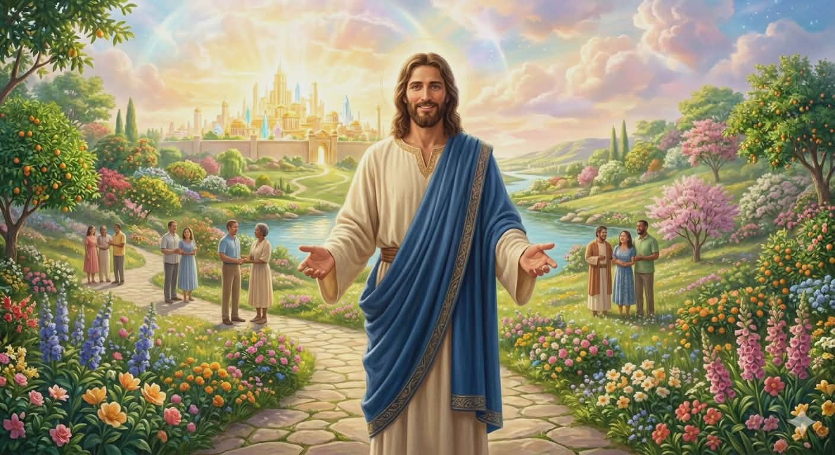
Important Principles on Stewardship
Prepared By:
Pastor Ildefonso A Baquilabat

Slide 2
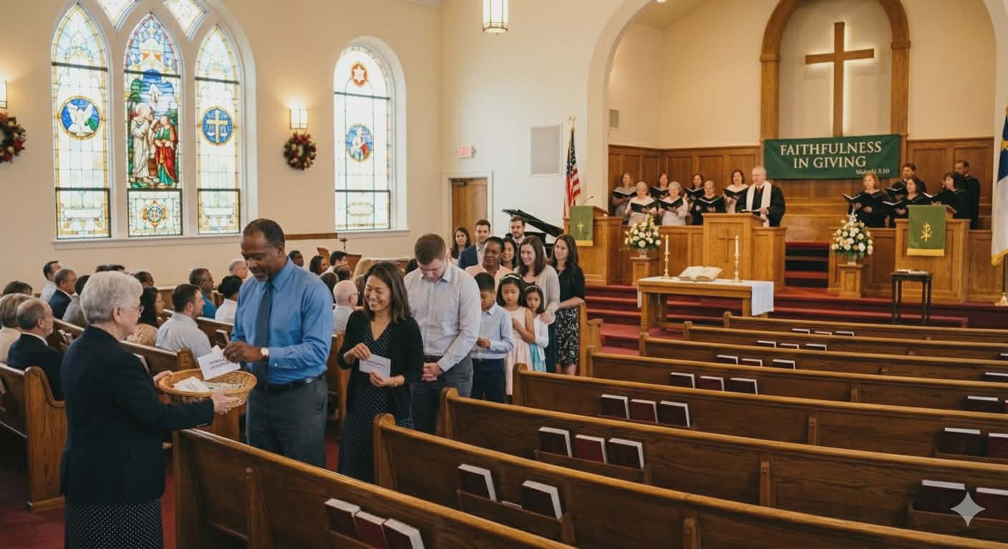
1. Generosity the Law of Heaven
“That man might be saved, He gave all that He had, and then gave Himself.
The cross of Christ appeals to the benevolence of every flower of the blessed Savior” (CS

Slide 3
Benevolence the Law of Heaven
Benevolence is the law of heaven.
Our mentality is often focused on receiving rather than giving.
When God gave, He gave everything and held nothing back.
His work is designed so that everyone may participate.
Although God can finish His work without our help, He invites us to participate so that we may grow.
Our participation is expressed through our support in tithes and offerings.

Slide 4
2. Be Sure to put Treasures only in God’s Storehouse
“There are only two places in the universe where we can place our treasures, in God’s storehouse or in Satan’s; and all that is not devoted to God’s service is counted on Satan’s side, and goes to strengthen his cause” (CS 35.4).

Slide 5
Be Sure to put Treasures only in God’s Storehouse
The purpose of our tithes and offerings is to support God’s work, and we are counseled to give liberally.
A warning has been given that if we do not give to God, we give to Satan.
When we withhold our giving, we strengthen the cause of Satan.
When we give, “the capacity to receive increases.”
This means that God gives abundantly to those who are generous, while blessings are withheld from those who are selfish.

Slide 6
3. Tithe is a Test of Loyalty to God
“He asks to acknowledge Him as the giver of all things; and for this reason He says, of all your possessions I reserve a tenth for Myself, beside gifts and offerings, which are to be brought into my storehouse” (CS 65.4)

Slide 7
Tithe is a Test of Loyalty to God
Tithe is a test of loyalty to God.
Adam and Eve fell into sin because of their disloyalty to Him.
God gave them a command, but they chose their own way, and the result was miserable.
Tithing is similar to Sabbath keeping.
Just as God set aside the Sabbath, He also set aside the tithe.
Faithfulness in keeping the Sabbath and returning tithes is an expression of loyalty to God.

Slide 8
4. Income Status will not Hinder to Return what Belongs to God
“The Lord will not look upon us with pleasure if we withhold anything, small or great, that should be return to Him” (CS 111.1)

Slide 9
Income Status will not Hinder to Return what Belongs to God
We cannot say to ourselves that we lack the capacity to give because we do not have enough.
God does not require much from those who have little.
He requires faithfulness in what we have, regardless of the amount.
One reason many poor people become poorer is that they believe only those who have enough are expected to give, and that they themselves are exempt.

Slide 10
5. Steward of Possessions
“Many do not seem to appreciate the fact that the money they needlessly expend on amusements which only vex the souls and lay the foundation for the corruption of their morals, is money that belongs to the Lord” (CS 135.3).

Slide 11
Steward of Possessions
Satan is constantly at work, using subtle methods to allure us.
We are tempted to accumulate riches solely for our own benefit, while God’s purpose is that His blessings be used to help finish His work.
Satan also seeks to divert our minds to other things.
Worldly pleasures are among his strongest allurements.

Slide 12
6. Poverty is not a Hindrance to Liberality
“When the apostle would have restrained them (Macedonian), they importuned him to accept their offering.
In their simplicity and integrity, and in their love for the brethren, they gladly denied self, and thus abounded in the fruit of benevolence” (CS 172.1).

Slide 13
Poverty is not a Hindrance to Liberality
The principle here is that when we fully give our hearts to God, we become true givers.
The Macedonian believers were not merely sharing; they gave joyfully and gladly in what they were doing.
Giving is not based on having enough, but on having a heart filled with the love of God.
This is liberality amid poverty.

Slide 14
7. Never Hesitate to Accept and to Ask Help from Gentiles
“The Lord God of Israel has placed His goods in the hands of unbelievers, but they are to be used in favor of doing the works that must be done for a fallen world.
The agents through whom these gifts come, may open up avenues through which the truth may go...”(CS 183.3).

Slide 15
Never Hesitate to Accept and to Ask Help from Gentiles
This book encourages us to solicit support from those who may not believe in God but who have a generous spirit.
Their riches ultimately come from God, and there is no wrongdoing in asking them for help.
This principle is drawn from the Bible, particularly from the period of the rebuilding of the temple in Jerusalem.

