Slide 1
Entrusted by God: Biblical Stewardship in Nurturing Children
Prepared By:
Pastor Ildefonso A. Baquilabat

Slide 2
Purpose of This Lecture
Why Are We Here?
To establish a biblical foundation for child stewardship
To recognize children as God’s sacred trust
To renew our commitment to faithful nurturing

Slide 3

1. Biblical and Ellen White Foundation for Child Stewardship

Slide 4

A. Stewardship of Time

Slide 5

A. Stewardship of Time
Time Is a Spiritual Investment
1. Presence – matters more than presents
2. Attention – deeper, more meaningful communication
3. Availability – planned visits or consistent communication

Slide 6
Insight from the Bible
“Train up a child in the way he should go: and when he is old, he will not depart from it.”— Proverbs 22:6 (KJV)

Slide 7
Insight from Ellen G. White
Time Is a Spiritual Investment
“Father… By withholding from them the time which is justly theirs, you rob them of the education which they should have at your hands.”— The Adventist Home, p. 191 (AH 191.3)
“ Mother… Never, never neglect your children. Let nothing interpose between you and the best interests of your children.”— The Adventist Home, p. 191–192 (AH 191.4)

Slide 8
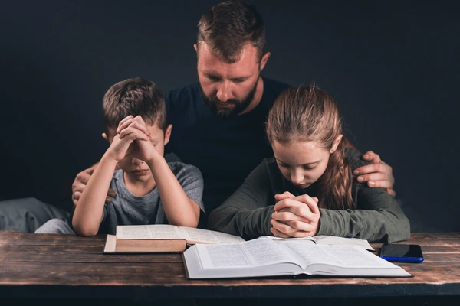

B. Stewardship of Influence

Slide 9
B. Stewardship of Influence
1. Faith is often caught, not taught.
2. Our Lives Are Living Sermons.
3. Children imitate before they understand.
4. Consistency builds trust and security

Slide 10
B. Stewardship of Influence
“Take heed that ye despise not one of these little ones…”
— Matthew 18:10 (KJV)

Slide 11
B. Stewardship of Influence
“Every act of life, every word spoken, every motive cherished, has its effect for good or for evil.”— Prophets and Kings, p. 86 (also cited as PK 86.1)

Slide 12
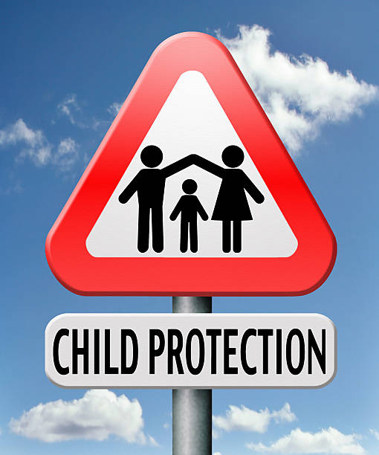
C. Stewardship of Protection

Slide 13
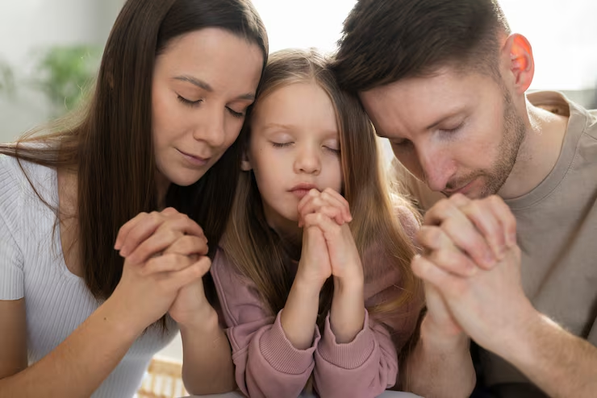
C. Stewardship of Protection
1. Live the faith in front of them – Show them that you pray, you read the Bible and you forgive others.
2. Create a safe spiritual environment - Pray together, worship regularly.
4. Guard what shapes their hearts - Be mindful of media, friendships, and influences.
5. Model repentance and grace - admit mistakes and ask forgiveness, children learn humility.
8. Surround them with a faith community - Healthy mentors, family, and community.

Slide 14
C. Stewardship of Protection
“Foolishness is bound in the heart of a child; but the rod of correction shall drive it far from him.”— Proverbs 22:15 (KJV).

Slide 15
C. Stewardship of Protection
“Many children are ruined for life because parents do not take the trouble to watch over them.”— Child Guidance, p. 229
“Never allow business, pleasure, or society to steal from you the precious hours that should be given to your children.”— The Adventist Home, p. 186

Slide 16

D. Stewardship of Teaching

Slide 17
D. Stewardship of Teaching
1. Identity – Help them feel that they are loved, valued, and created with purpose.
2. Love and kindness - How to love God, love people, and show compassion.
3. Right and wrong - Help them understand why something is right or wrong.
4. Faith and trust - Teach them to pray, to trust God in hard times,
5. Gratitude - Help them recognize blessings and say thank you.
6. Self-control and discipline - Teach patience, obedience, and wise decision-making.
8. Respect for others- Teach respect for parents, elders, authority, peers, and differences. Respect builds healthy relationships.
9. Responsibility and service - Teach them to help, serve, and contribute.

Slide 18
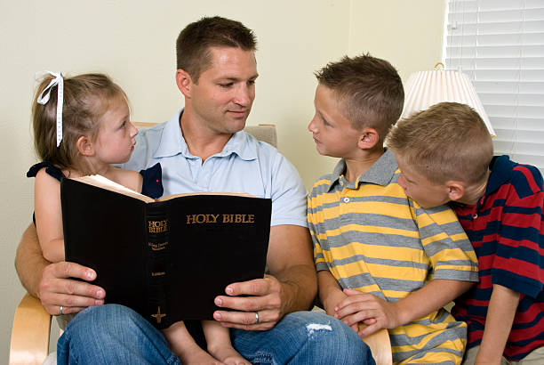
D. Stewardship of Teaching
“And thou shalt teach them diligently unto thy children, and shalt talk of them;
1. when thou sittest in thine house,
2. and when thou walkest by the way,
3. and when thou liest down,
4. and when thou risest up.” — Deuteronomy 6:7 (KJV)

Slide 19
D. Stewardship of Teaching
“The home is the child’s first school, and the mother is the child’s first teacher.”— Child Guidance, p. 17
“From the earliest years children should be taught lessons of obedience, self-control, and submission.”— Child Guidance, p. 67
“What parents are, that, to a great extent, the children will be.” — The Adventist Home, p. 217
“The education and training of children is the noblest missionary work that any man or woman can undertake.”— Counsels to Parents, Teachers, and Students, p. 165
“Children left to grow up without proper instruction are a burden to society.” — Child Guidance, p. 229

Slide 20

2. Children are A Sacred Trust

Slide 21
2. A Sacred Trust
1. Children Are Entrusted, Not Owned
2. Children are priceless and irreplaceable
3. God places them in human care temporarily

Slide 22
Children Belong to God
A Foundational Truth
1. Not first to parents
2. Not first to the church
3. Not first to society
They belong to God

Slide 23
Spirit of Prophecy Insight
Ellen G. White
“Children are the heritage of the Lord, and they are to be trained for His service.” (Child Guidance, p. 499)
Parenting is preparation for God’s service
Eternal purpose, not just earthly success

Slide 24
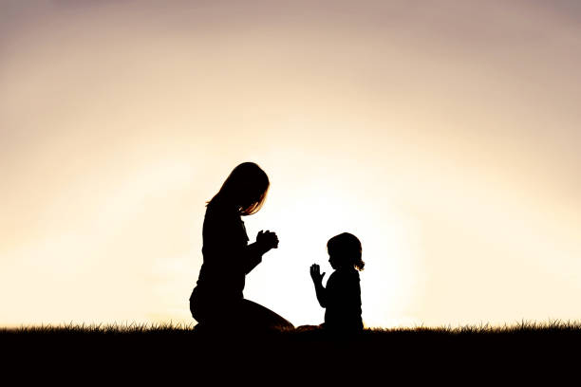
3. Faithfulness Begins Early

Slide 25
3. Faithfulness Begins Early
Why the Early Years Matter?
1. Character formation starts young
2. Habits and values take root early
3. Early impressions often last a lifetime

Slide 26
First Seven years – Character Forming
The lessons that the child learns during the first seven years of life have more to do with forming his character than all that it learns in future years. CG 193.1

Slide 27
Closing Text
Psalm 127:3
“Children are the heritage of the Lord…”
They are the church, witnesses, and servants of tomorrow.

