Slide 1
Stewardship of Talents and Gifts
Prepared By:
Pastor Ildefonso A. Baquilabat

Slide 2

Introduction
God never saves people to be idle. Salvation places us into service. Each believer is entrusted with gifts that belong to God and are meant to be used.
“Every true disciple is born into the kingdom of God as a missionary.” —Ellen G. White, The Desire of Ages, p. 195
Illustration: The Assigned Seat Imagine boarding a plane and refusing to sit in your assigned seat because you think someone else will sit there. The flight cannot function properly until everyone is in place.
Lesson: The church cannot function fully until every believer takes their God-given place.

Slide 3

1. God Entrusts Every Believer with Gifts
Bible Text
“Unto one he gave five talents, to another two, and to another one; to every man according to his several ability.” —Matthew 25:15 (KJV)
Ellen White
“All men have been entrusted with talents, and these are to be used to the glory of God.” —Christ’s Object Lessons, p. 328
Illustration: The Toolbox A toolbox has many tools hammer, wrench, screwdriver. None can do every job, but each is essential.
Lesson: Different gifts serve different purposes. No gift is unnecessary, and no believer is ungifted.
What you have right now don’t hesitate to use it. It is God’s gift.

Slide 4
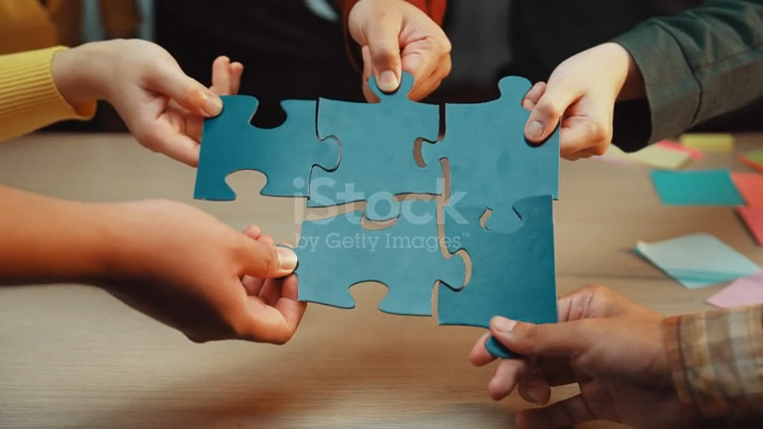
2. Faithfulness Is Measured by Use, Not Size
Bible Text
“Well done, thou good and faithful servant.” —Matthew 25:21, 23 (KJV)
Ellen White
“The reward is not proportioned to the amount of work done, but to the faithfulness with which the work is performed.” —Christ’s Object Lessons, p. 330
Illustration: Two Bank Accounts One person deposits large amounts rarely. Another deposits small amounts consistently. Over time, the second account grows steadily.
Lesson: God values consistent faithfulness more than impressive but irregular effort.
The same is true with tithes and offerings: God values small but faithful giving more than large but unfaithful giving.

Slide 5

3. Fear Causes Gifts to Be Buried
Bible Text
“I was afraid, and went and hid thy talent in the earth.” —Matthew 25:25 (KJV)
Ellen White
“Many who might be fruitful in the service of God become paralyzed by fear.” —Christ’s Object Lessons, p. 364 (paraphrased)
Illustration: The Lifeboat That Never Launched A lifeboat was kept perfectly clean and safe in the harbor—but it never saved anyone because it was never launched.
Lesson: Gifts kept safe but unused never fulfill their purpose.

Slide 6

4. Gifts Are Given to Be Used in Service
Bible Text
“Having then gifts differing according to the grace that is given to us… let us use them.” —Romans 12:6 (KJV)
Ellen White
“Christ expects every man to do his duty faithfully.” —Christ’s Object Lessons, p. 356
Illustration: The Empty Chair An empty chair in church represents an unshared testimony, an unoffered prayer, an unmet need.
Lesson: When one believer chooses not to serve, the whole body feels the loss.
The same is true with tithes and offerings: unfaithfulness in returning them disturbs the flow of God’s blessings in the church.

Slide 7
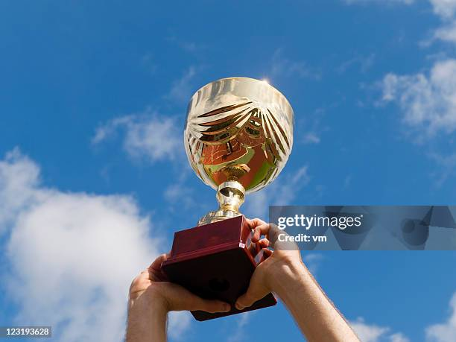
5. God Rewards Faithfulness
Bible Text
“Enter thou into the joy of thy lord.” —Matthew 25:21 (KJV)
Ellen White
“Talents used are talents multiplied.” —Christ’s Object Lessons, p. 353
Illustration: The Growing Muscle A muscle unused becomes weak. A muscle exercised grows stronger.
Lesson: Spiritual gifts grow through use, not preservation.

Slide 8

Application
Discover — Ask God, “How have You gifted me?” Develop — Practice and improve what God has given. Deploy — Use your gifts now, where you are.
“The Lord desires us to use every gift we have; and if we do this, we shall have greater gifts to use.” —Christ’s Object Lessons, p. 329

Slide 9
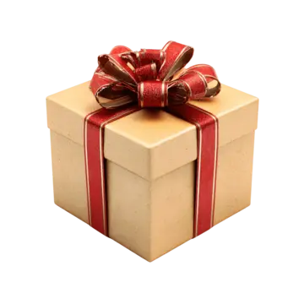
Conclusion
One day, every believer will give an account. The tragedy of the one-talent servant was not that he had little—but that he did nothing.
Final Illustration: The Unopened Gift A gift left unopened benefits no one—not the giver, not the receiver.
Final Truth: Buried gifts are wasted opportunities.
May we be found faithful stewards and hear those precious words:
“Well done, good and faithful servant.” Amen.

