Slide 1
SERMON TITLE: “THE OWNER AND THE MANAGER”
Prepared By:
Pastor Ildefonso A. Baquilabat

Slide 2
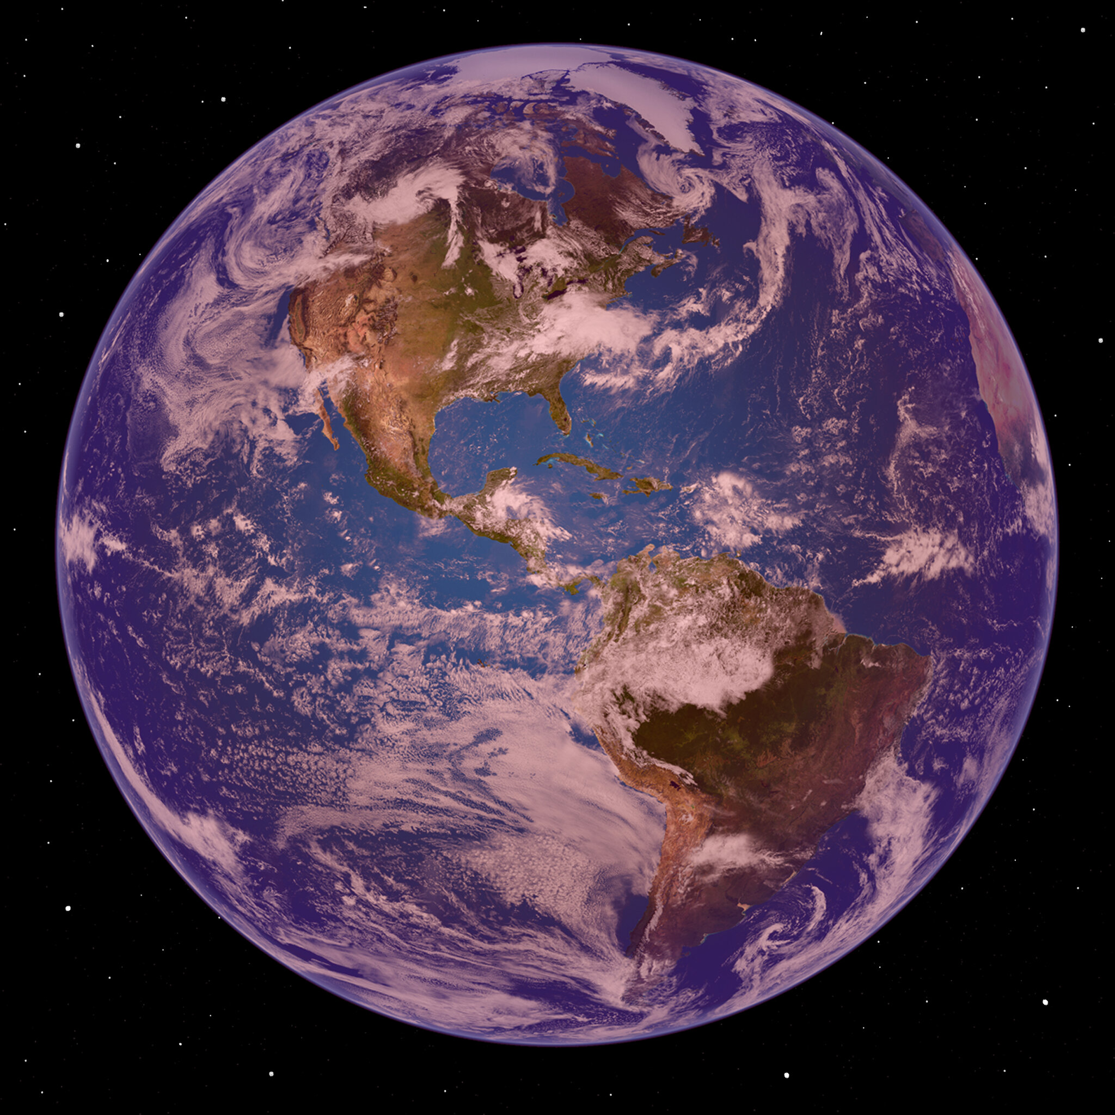
Scripture Reading
“The earth is the Lord’s, and all its fullness, the world and those who dwell therein.”— Psalm 24:1
“Let a man so consider us, as servants of Christ and stewards of the mysteries of God. Moreover it is required in stewards that one be found faithful.”— 1 Corinthians 4:1–2

Slide 3
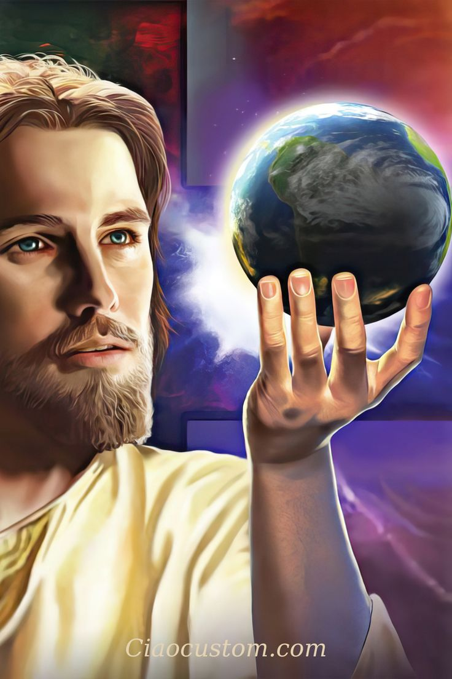
INTRODUCTION
One of the greatest misunderstandings in human life is the belief that we own what we have. Society teaches us to say, “This is mine—my money, my house, my time, my life.”
But the Bible begins stewardship with a radically different truth: God is the Owner. We are only managers.
Stewardship does not begin with giving—it begins with recognizing ownership. Until we understand who owns everything, we will never fully understand our responsibility.

Slide 4
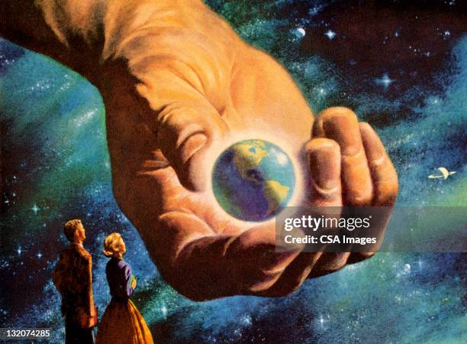
1. GOD IS THE ABSOLUTE OWNER
David declares without hesitation:
“The earth is the Lord’s, and all its fullness.” — Psalm 24:1
A. Not part of the earth.
B. Not most of it.
C. All of it.
That includes:
A. Our lives
B. Our bodies
C. Our abilities
D. Our time
E. Our possessions
Ellen G. White affirms this clearly:
“God is the owner of heaven and earth. All things are His.”— Counsels on Stewardship, p. 68
We brought nothing into this world, and we will take nothing out. Everything we possess is temporarily placed in our hands by God.
When we forget this truth, pride grows. When we remember it, humility and faithfulness grow.

Slide 5
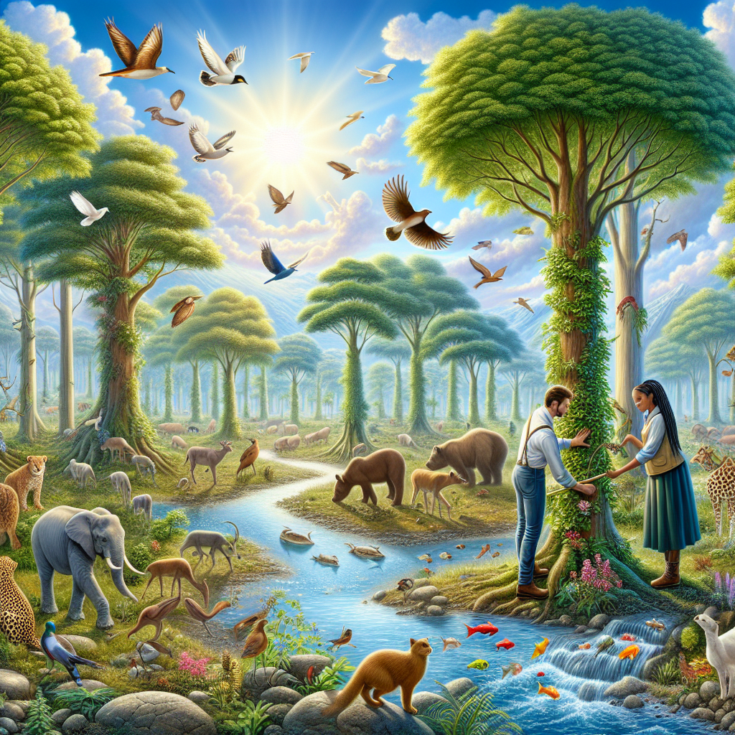
2. WE ARE STEWARDS, NOT OWNERS
Paul explains our position:
“Let a man so consider us, as servants of Christ and stewards…”— 1 Corinthians 4:1
A. A steward is not the owner of the estate.
B. A steward manages on behalf of the owner and will one day give an account.
Ellen White defines stewardship this way:
“A steward identifies himself with his master. He accepts the responsibilities of a steward, and he must act in his stead, doing as his master would do if he were presiding.”— Counsels on Stewardship, p. 23
This means our choices should reflect God’s character, not personal convenience. We ask not, “What do I want?” but “What would the Owner desire?”

Slide 6
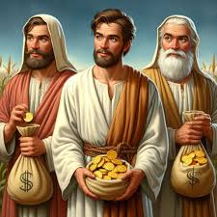
3. FAITHFULNESS IS THE REQUIREMENT
God does not require stewards to be famous, wealthy, or successful—He requires them to be faithful.
“Moreover it is required in stewards that one be found faithful.”— 1 Corinthians 4:2
Faithfulness means:
A. Obedience when no one is watching
B. Integrity in small things
C. Trustworthiness with God’s resources
Ellen White writes:
“It is faithfulness, not genius, that God requires.”— Education, p. 57
Heaven does not measure success the way the world does. God measures faithfulness to trust.

Slide 7
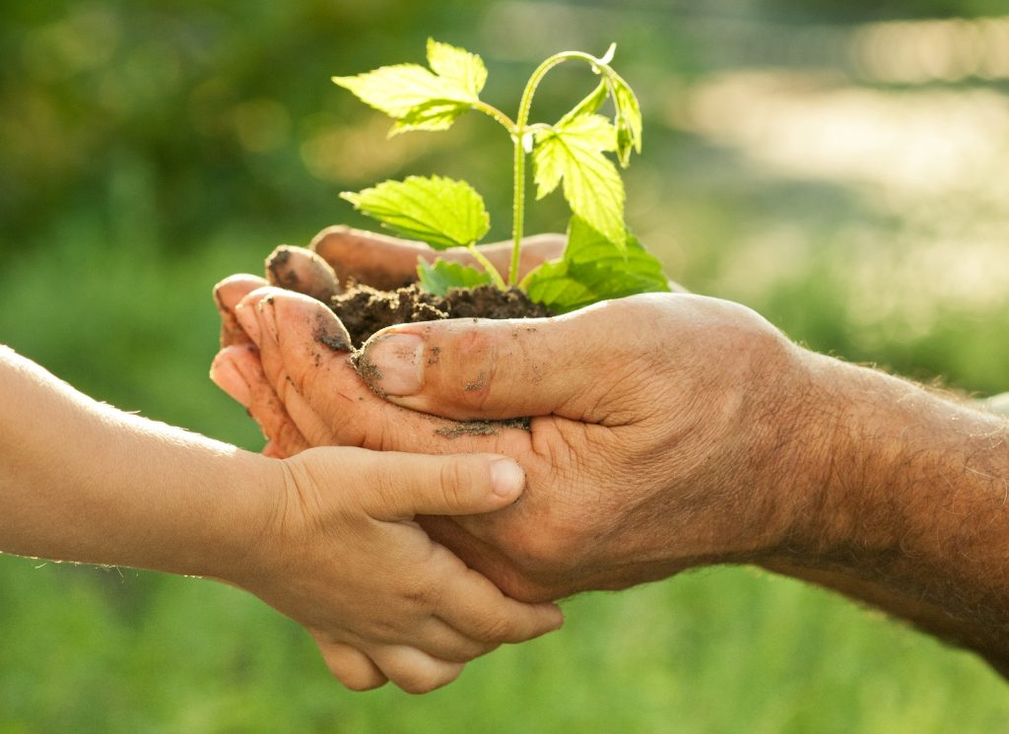
4. WHAT HAS GOD ENTRUSTED TO US?
God has entrusted us with far more than money.
Ellen White says:
“God has entrusted men with talents and means to be used for His glory. All that we have is the Lord’s.”— Christ’s Object Lessons, p. 325
These trusts include:
A. Time
B. Health
C. Talents and spiritual gifts
D. Influence
E. Material possessions
Every blessing carries responsibility. Every privilege comes with accountability.

Slide 8
5. FROM “MY STUFF” TO “GOD’S TRUST”
The practical application of stewardship is a change in mindset.
Instead of:
A. My money → God’s provision
B. My time → God’s opportunity
C. My talents → God’s tools
Jesus teaches this principle clearly:
“He who is faithful in what is least is faithful also in much.”— Luke 16:10
Ellen White warns:
“Those who regard their means as their own will fail to render to God the things that are His.”— Counsels on Stewardship, p. 67
When we recognize God as Owner, generosity becomes natural, obedience becomes joyful, and sacrifice becomes meaningful.

Slide 9
CONCLUSION
A. Stewardship begins with one foundational truth:
B. God owns everything.
C. We manage what He entrusts.
D. One day, every steward will stand before the Owner.
E. On that day, God will not ask how much we accumulated, but how faithfully we managed what He placed in our hands.
F. Jesus longs to say to each of us:
“Well done, good and faithful servant.”— Matthew 25:21

Slide 10
CONCLUSION
If we understand that we are stewards of the things that belong to God:
A. We should truly demonstrate faithfulness in returning our offerings and tithes. B. We should also devote time to His work. C. We should take care of our physical health. D. Use your talents and spiritual gifts for His glory. E. Exhibit a good influence on others. F. And help others through material things.

